Slide 1





Blockchain in Healthcare
Today & Tomorrow
September 15, 2022
Central Public Library
Austin, TX USA
  “Hi dear, the doctor is here –
  Where is our EMR wallet?”
Milan Shah, Chief Technology Officer, Biofourmis
2022

Slide 2
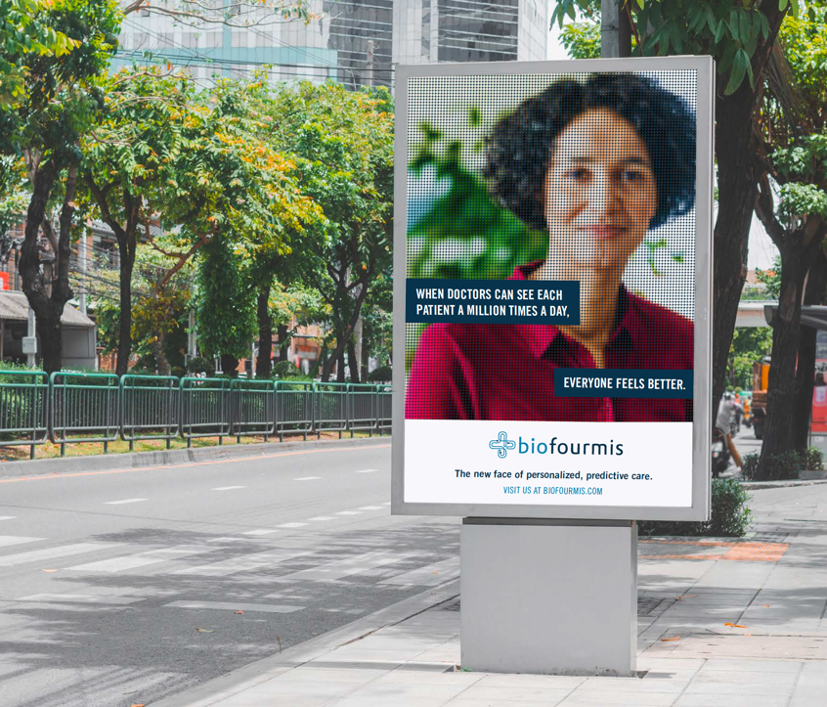


POWERING
PERSONALIZED PREDICTIVE CARE
Hi Dear, the doctor’s here – where is our EMR wallet?
ConV2X Austin
September 2022

Slide 3

Milan Shah, Chief Technology Officer
.
milan.shah@Biofourmis.com

Slide 4
Agenda
Care@Home - The perfect storm and the disruption
Predictive technologies and early intervention
Who’s creating the EHRs?
Care@Home and the EMR Wallet
Three take-aways

Slide 5
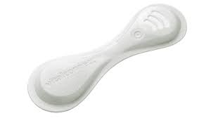

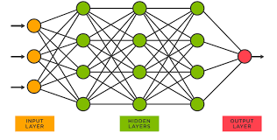

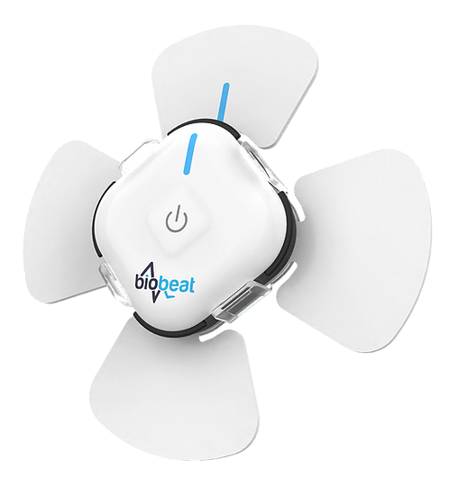
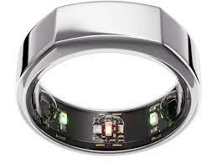
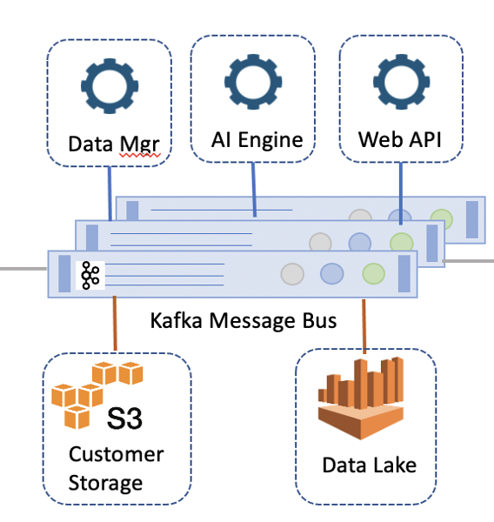
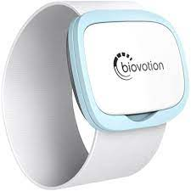
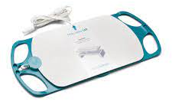
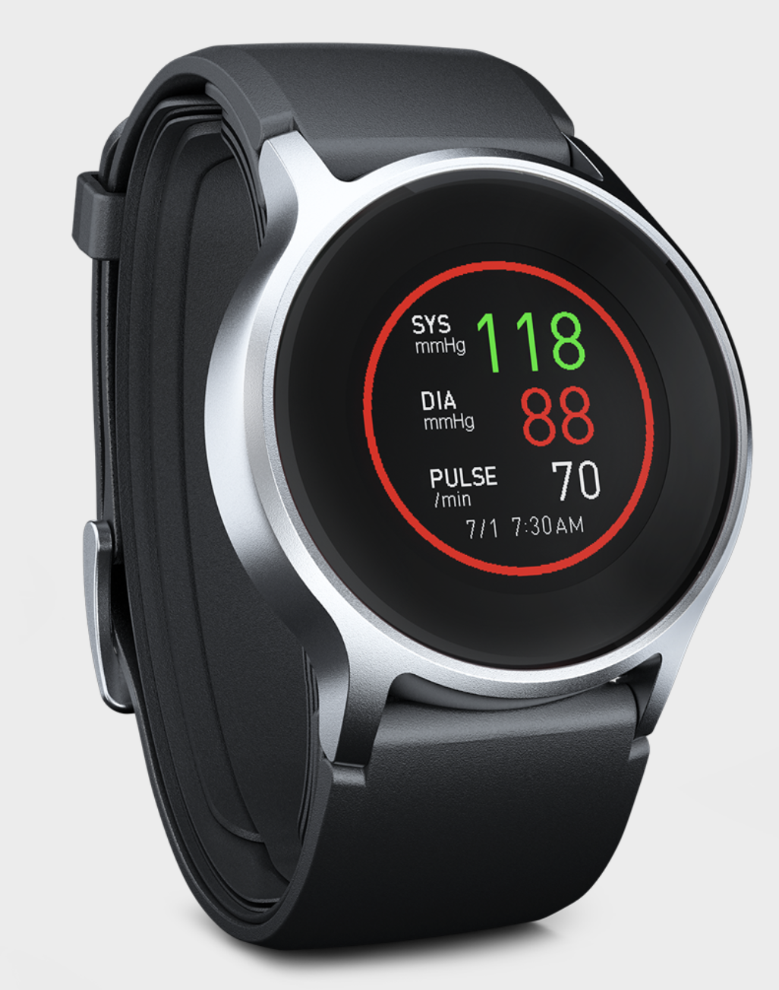
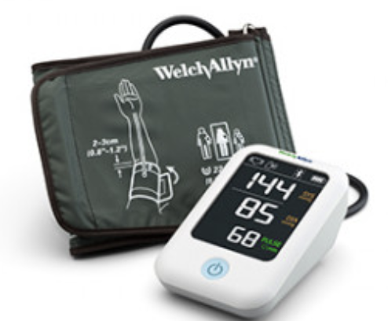
Care@Home – The perfect storm and the disruption
1. Sensors
2. Compute
3. AI/ML

Slide 6
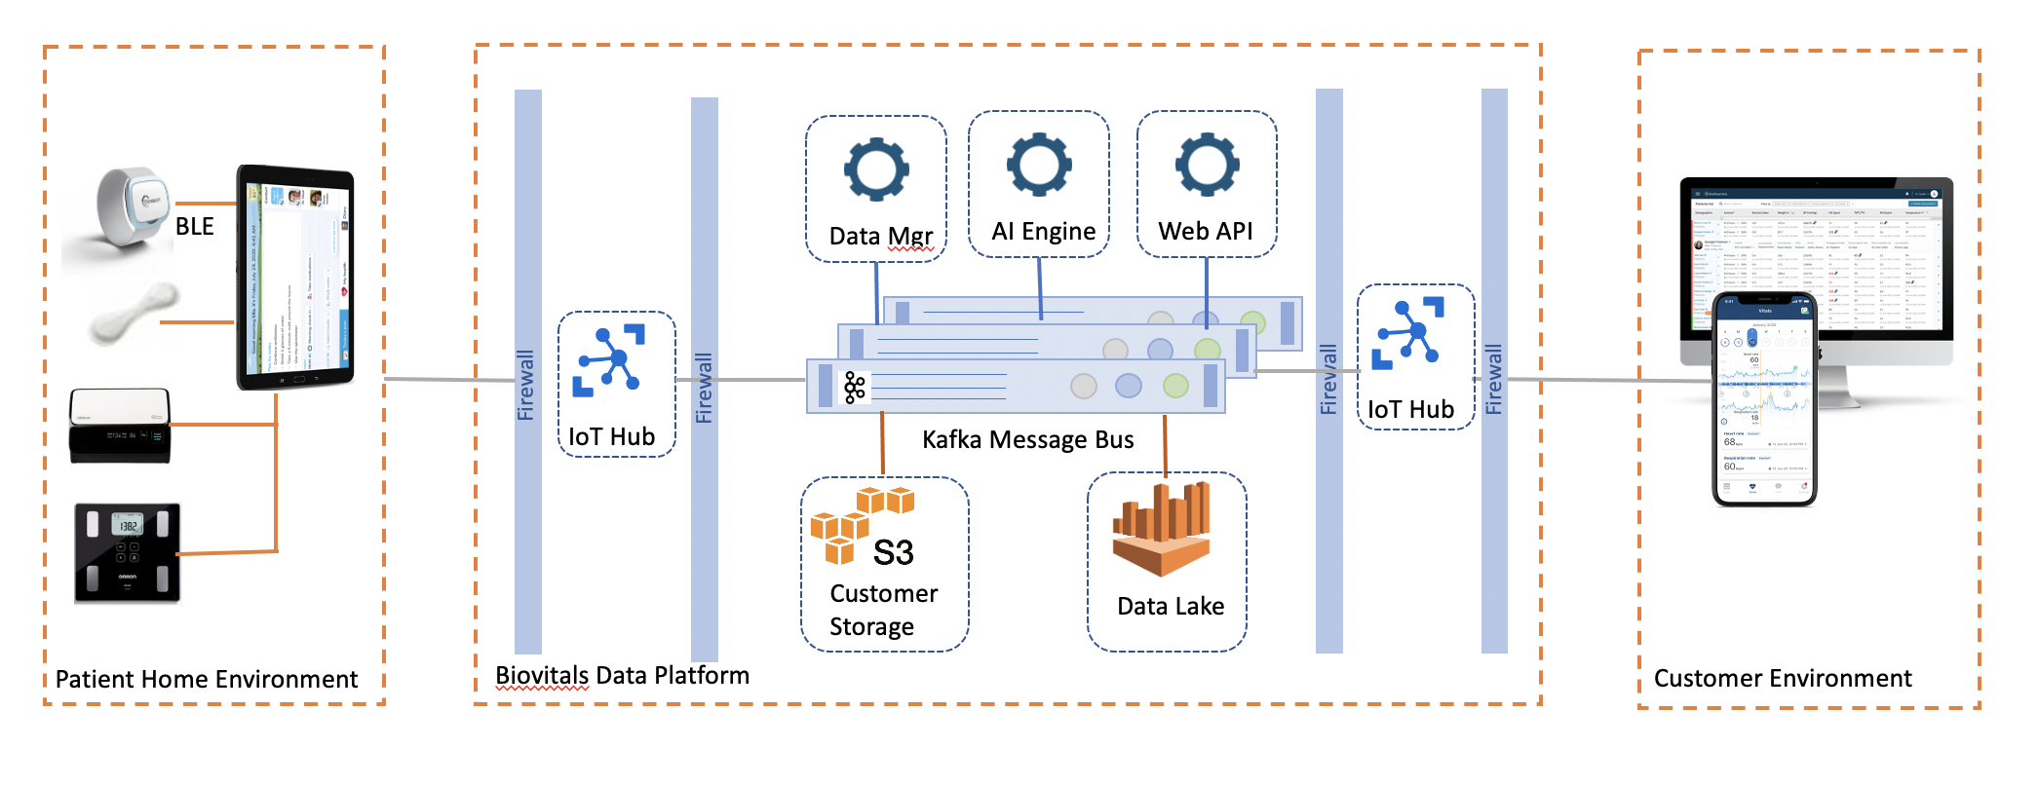
Care@Home - Deployment
Runtime

Slide 7
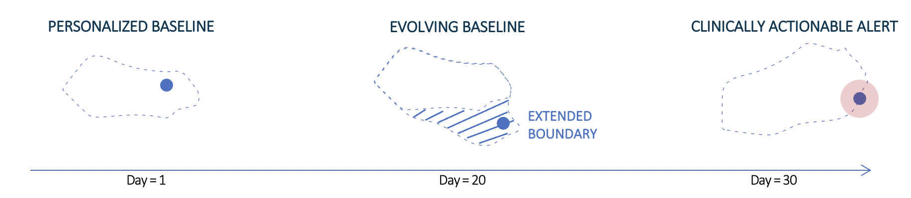
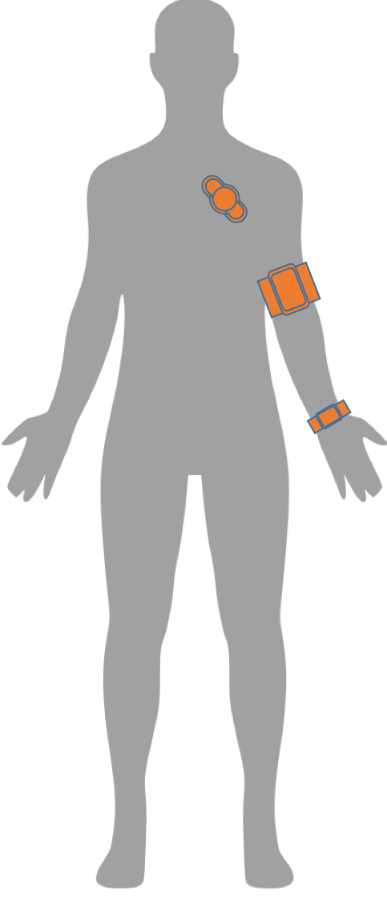
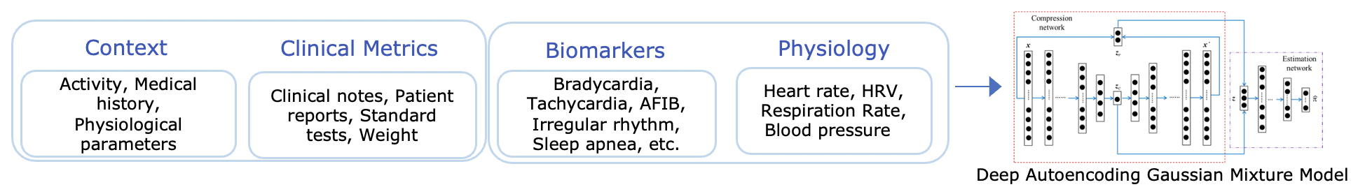

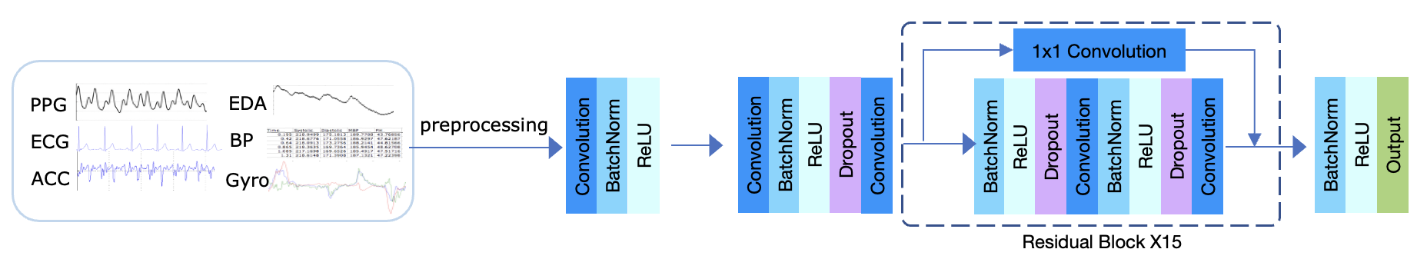
Biovitals® – a personalized (N=1) health platform
THERAPEUTIC
DYNAMICALLY VARYING PERSONALIZED HEALTH SIGNATURE
BEHAVIOUR
Software-based Intervention
WEARABLE BIOSENSORS & COMPANION APP
>5 Million
Data Points per Day
(N=1)
HYPERDIMENSIONAL CLINICAL FEATURES – PERSONALIZED, DYNAMIC CLINICAL CARE PATHWAY
FDA, QMS, SDLC and HIPAA compliance
EXTRACTING 100+ DIGITAL BIOMARKERS
Biovitals® Data Lake: >6 Million Patients Annotated Clinical Data
CARDIOLOGY | ONCOLOGY | RESPIRATORY | PAIN

Slide 8
Cytokine Release Syndrome (CRS)
Chimeric Antigen Receptor (CAR) T-cell therapy revolutionizes management of cancer
Generalized activation of immune system leads to a profound systemic inflammatory response
CRS is a major severe adverse event of immunotherapies
  Rapid onset of elevated levels of cytokines manifest clinical symptoms/side effects impacting most organs
  Could lead to multi-organ failure in days to weeks
Timely immunosuppression can minimize the CRS events and maximize the benefit of immunotherapies
  Tocilizumab (anti-IL-6R-Ab) w/wo corticosteroids
Biovitals Platform can effectively monitor patients’ vitals signs, predict CRS risks & events in advance using AI algorithms, and improve the clinical outcomes
Shimabukuro-Vornhagen et al, J Immunotherapy of Cancer 2018; 6:56
Perez et al, ASH 2015.

Slide 9
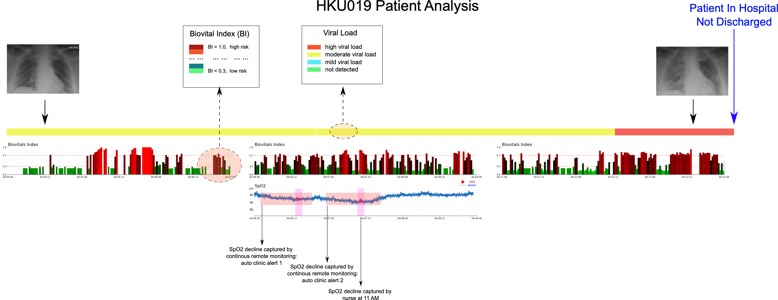
Remote Monitoring for COVID Patient: The Sentinel Study
Biovitals Index / Device SpO2 (Continuous) vs. SpO2 (Episodic) vs. Clinical Events
Study population: Thirty-four patient with mild COVID-19 from Queen Mary Hospital were recruited [1]
Case study:
Continuous SpO2 warning triggered twice by the device, several hours earlier than episodic measurement events (O2 support event).
Continuous physiological data and machine learning model (Biovitals Index) predict the patient health status, relevant to clinical events (low SpO2) and endpoints (discharge or not).
[1] *UN, Ka-Chun, et al. Observational study on wearable biosensors and machine learning-based remote monitoring of COVID-19 patients. Scientific reports, 2021, 11.1: 1-9.

Slide 10
Who’s creating the EHR?
Continuous monitoring, continuous analysis -> Stream of medical records
  Overnight – Sleep Apnea, CRS onset…
  Continuous – Afib burden, blood glucose monitoring…
EHR records effectively “created by patients”
Of course, in addition to the EHRs created by care providers

Slide 11
Care@Home and the EHR Wallet
EHR Wallet likely to be the most effective way to assemble complete picture of patient’s medical profile and history.
Care co-coordination – variety of service providers will provide service at home.
  Acute, post-acute, chronic phases
  Virtual patient management
Need for EHRs in Wallet to be:
  Adjuticated
  Validated
  Aggregated
  Shared on an episodic, time bound, or permanent basis

Slide 12
Three take-aways
Clinical practice is moving to the home – disruptive forces at play
Increasing need for patient centric (decentralized) EHR systems
  Will ”network of networks” be relevant in this new world?
Complex workflows in patient app/EHR Wallet

