Slide 1


Building Blockchain-powered
Trusted Digital Health Services. Estonia
Ain Aaviksoo, MD MPH
ain.aaviksoo@guardtime.com | @ainaaviksoo
Chief Medical Officer, Guardtime
the coolest digital society

Slide 2
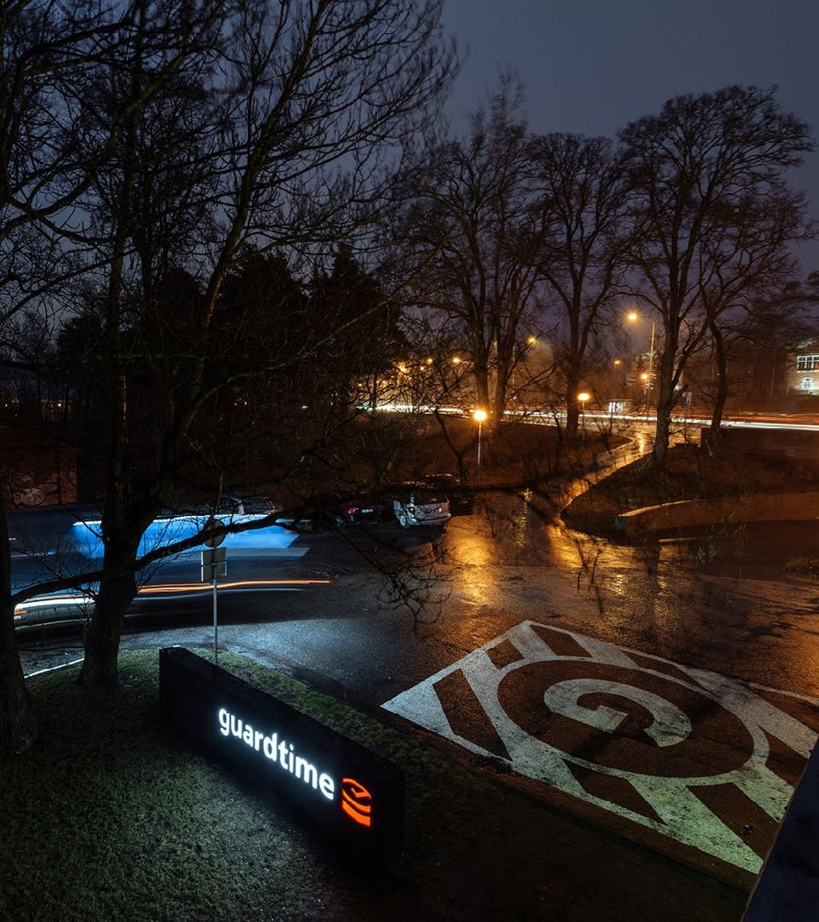
GUARDTIME
/The world’s largest blockchain Technology company by revenue, head count and production deployments.
FOUNDED: 2007 in Tallinn, Estonia
GLOBAL HQ: Lausanne, Switzerland
PERSONNEL: 200 FTE, 80% in R&D, offices in US, EU and China
VALUE PROPOSITION: The only blockchain-backed technology platform that is proven to work at scale, used in production by the US military and some of the largest companies in the world to solve data management challenges.
FUNCTIONAL OFFERINGS IN HEALTH DOMAIN:
  HELIUM (Data Access and Governance Manager)
  Data Access for Outcomes Based Pricing
  Dynamic Patient Consent Engine (GDPR)
  Medicine Supply Alert
  Secure Data & Process Integrator for Medication Adherence
  Supply Chain Track and Trace
  Complex Clinical Trial Data & Process Integrator
ACCREDITATION: Technology has been accredited by US, EU and China regulators for deployment on to government networks.
REFERENCES: Lockheed Martin, Ericsson, Estonian Health Information System, Verizon, UK NHS, Governments (US, China, EU, Estonia, Netherlands, etc.)

Slide 3
The context

Slide 4
Estonia is digital all over – not just in healthcare
Entire country is covered with a broadband connection
99% of state services
are online
98% of the population has an ID-card
1st country to use blockchain on national level
5 days and 2% of GDP per year is saved with digital signatures
30% of the population uses i-Voting

Slide 5
business is digital
98% of companies established online
99% of banking done online
95% of tax declarations filed online
e-Residency – freedom for everyone to run a global EU company fully online

Slide 6
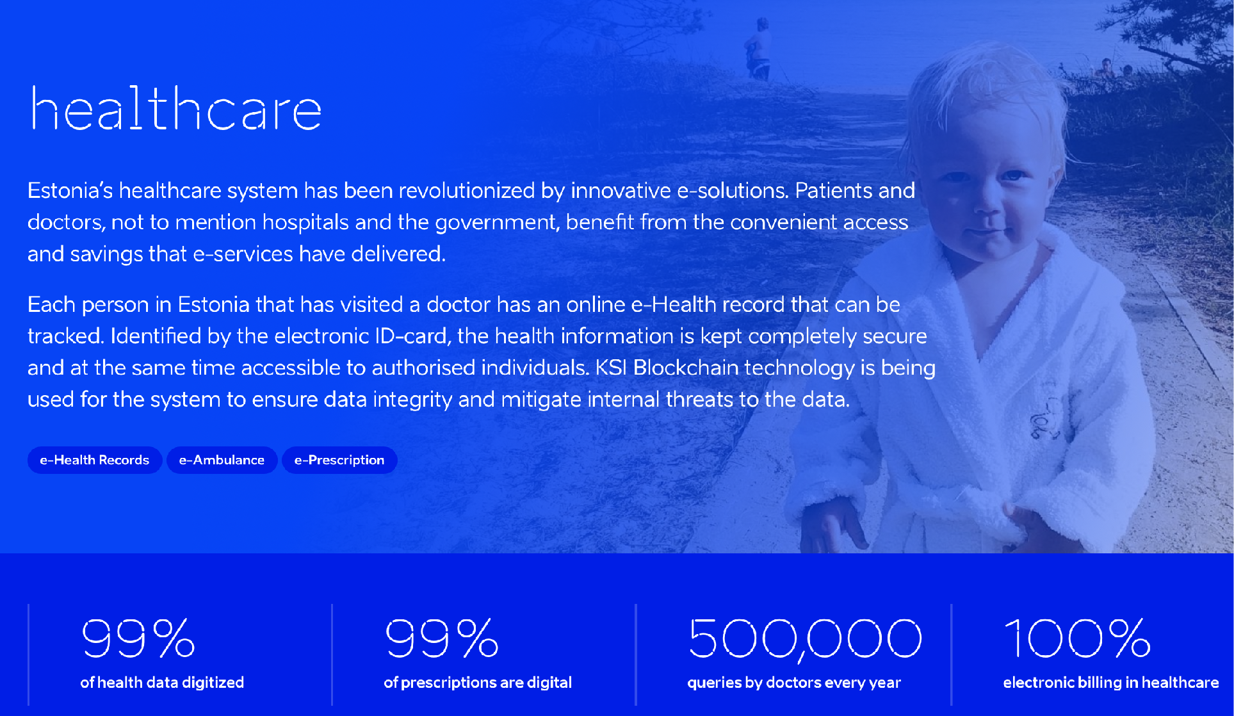
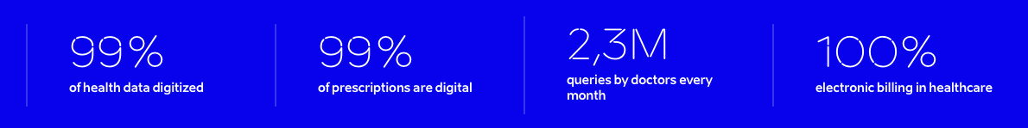
is digital within this context
Notes:
And yes – digitization of Estonian health system started in the 1990s of last century. Our family doctors were almost fully digital 15 years ago and today 30% of all traffic on national secure transport service x-road comes from health care services.
Health care is very data intensive activity, as you all know

Slide 7
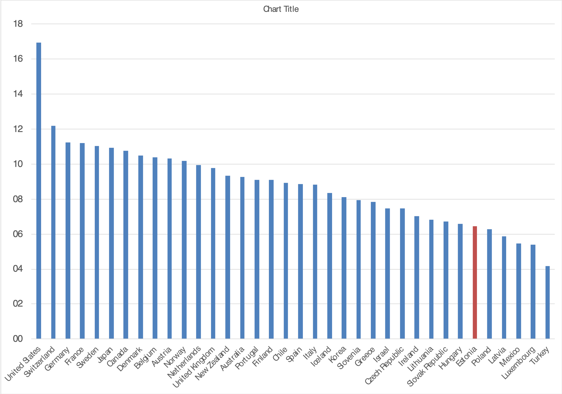
High digitalisation drives
/ high quality & high efficiency
Estonia has one of the lowest health expenditures (6.2% of GDP) in OECD

Slide 8
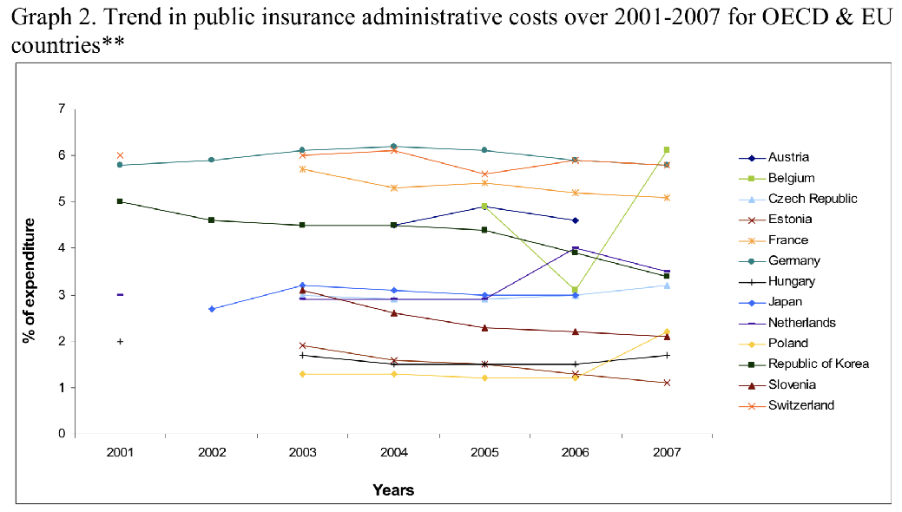
High digitalisation drives
/ high quality & high efficiency
Close to average (and improving)
care quality among EU countries
Health insurance administrative costs among the lowest in EU

Slide 9

empowering
Easiest life: only getting married or divorced and selling real estate cannot be done online.
Yet.
© Tõnu Runnel

Slide 10
The beginning

Slide 11











E-ESTONIA TIMELINE
/ FROM VISION TO RESILIENT GROUNDWORK
e-school
e-tax
board
population
registry
digital
signature
id bus
ticket
m-parking
x-road
id-card
e-land
registry
EHIS
i-voting
2000
2001
2002
2003
2004
2005
Notes:
16. Timeline, VOL1
The development of e-Estonia has not happened in one day – it took us 17 years to start from changing legislation and creating our first e-solutions.
The speaker should point out some of the e-solutions that are connected most to the audience. For example:
2000 – Estonia had an online e-Tax Board already in 2000, while many other countries have created similar online versions only in recent years.
2005 – Estonia was the first country in the world to use i-Vote in 2005. Since then, there have already been 9 elections in Estonia where people could cast their vote using i-vote – 30% of Estonians cast their vote via the i-voting system from 128 countries all over the world.

Slide 12








E-ESTONIA TIMELINE:
/ FROM CHALLENGE TO OPPORTUNITIES
cyber-attacks
DDoS
mobile-id
KSI
blockchain
e-police
system
e-health
system
ev quick
charging
network
x-road
europe
e-prescriptions
smart grid
2007
2008
2010
2011
2012
2013
Notes:
17. Timeline, VOL2
The speaker should point out some of the e-solutions that are most connected to the audience. For example:
2008 – After Estonia’s experience with the 2007 cyber attacks, scalable KSI Blockchain technology was developed by the Estonian company Guardtime and tested in government systems to ensure the integrity of the data stored in government repositories and to protect the data against similar threats.
2013 – Estonia was the 1st in the world to interconnect decentralized components of state and public sector databases on an international level, while starting to building up the digital market in Europe and offering its X-Road experience to other countries. As a result, a public sector data exchange facility between Finland and Estonia was created in 2017.This means that e.g. in the future health or education data belonging to Estonian citizens can also be accessed by the Finnish government or private sector, no matter whether the person is living in Estonia or Finland.

Slide 13
2007 lesson
/ from Cyber attacks
THE CHALLENGE:
Prove the time, integrity and origin/provenance (human or machine) of any electronic data asset, without reliance on centralized trust authorities.
When digital copy of anything to be known about your country and people becomes the main source
for decision making - you want
this truth to be immutable
Notes:
As you probably know, in 2007, Estonia had experience with state-level cyber-attacks and they had a challenge – how to ensure the integrity of our digital registries. Already back then it was clear that Estonia’s path is fully digital governance – so we had to be sure that the data and systems we use for it, are secure and tamper-evident.
There were three challenges:
- The ability to trust government data 100% in any situation is one of the foundational capabilities for any Nation-State.
- The ability to enforce the integrity of the data allows to effectively mitigate insider threat focused at manipulating with and abusing the stored data.
- The ability to verify the integrity of government data independently of its home database, in real-time, enables data interoperability between systems and across boundaries.
So the Estonian government started to find a solution to those challenges. And luckily Estonian cryptographers had a solution to it – original academic research that is the basis of technology known as KSI Blockchain.

Slide 14


KSI BLOCKCHAIN
/ PRIVACY BY DESIGN
KSI BLOCKCHAIN
Data NEVER leaves the system
(only hash is sent to blockchain service) – privacy maintained!
/ KSI SIGNATURE PROVES
Asset Integrity
Signing Time
Signing Entity
+
DATA
+
HASH
+
PROOF OF
REGISTRATION
CUSTOMER ENVIRONMENT

Slide 15
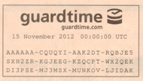
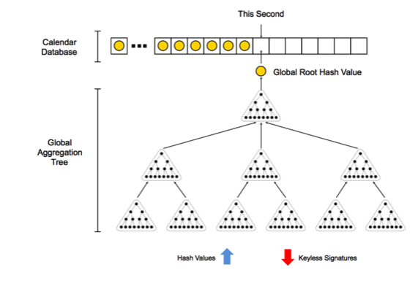
KSI BLOCKCHAIN
/ Scalability
Every second hash-values of new data created are submitted into the hash tree.
A unique hash-chain is returned which later can be used to prove that the hash-value participated in the computation of the root.
Every second a new hash tree is built with new data and only the root hash values are kept in a public Blockchain to which everyone has access.
The Blockchain grows at 1 hash value per second – or 2GB per year using SHA-256.
Notes:
So what we do – we gather together all incoming hashes, form into a huge, aggregated hash tree – and put that tree root to a blockchain. (Or well – to be a bit more accurate (but not go into the details too much) the blockchain core nodes reach a consensus over the top root value of such tree and then everybody updates their ledger.)
We do this process once a second – so just one hash value a second goes to the blockchain. These values are chained together in the ledger by another tree – making it impossible to change history. And ultimately – we create a link to the real world.
The blockchain itself is public and shared between all the customers and is therefore really widely witnessed. But we take a step further and print a root hash value of the blockchain tree to a physical newspaper

Slide 16
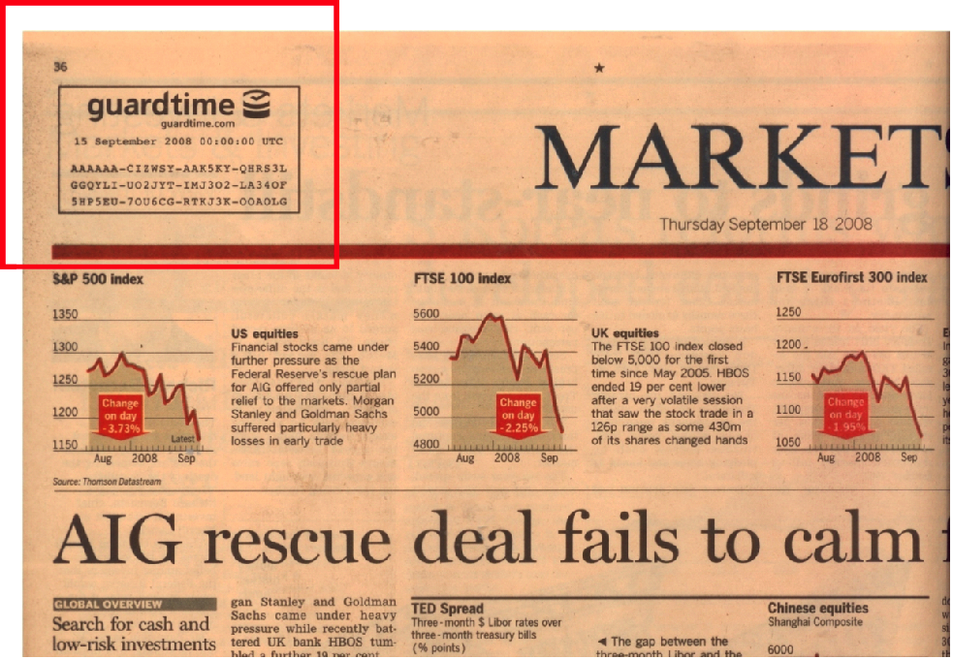
KSI BLOCKCHAIN
/ HIGHLIGHTS
Proves the integrity and time
of any piece of data
1-second time-resolution
1-second response time
Any number of KSI signatures per second
Widely witnessed trust anchors in newspapers and electronic media
Independent offline verification (verification code open source)
Privacy - no need to expose data
No key management
Telcom grade reliability, 99,995%
Quantum immune

Slide 17
KSI BLOCKCHAIN
/ GUARDING THE INTEGRITY OF DATA & PROCESSES
operational
from 2008
cloud
assurance
real-time awareness
Availability, redundancy,
scalability
Accountability, attribution
and transparency
Insider threat
Data breach management

Slide 18
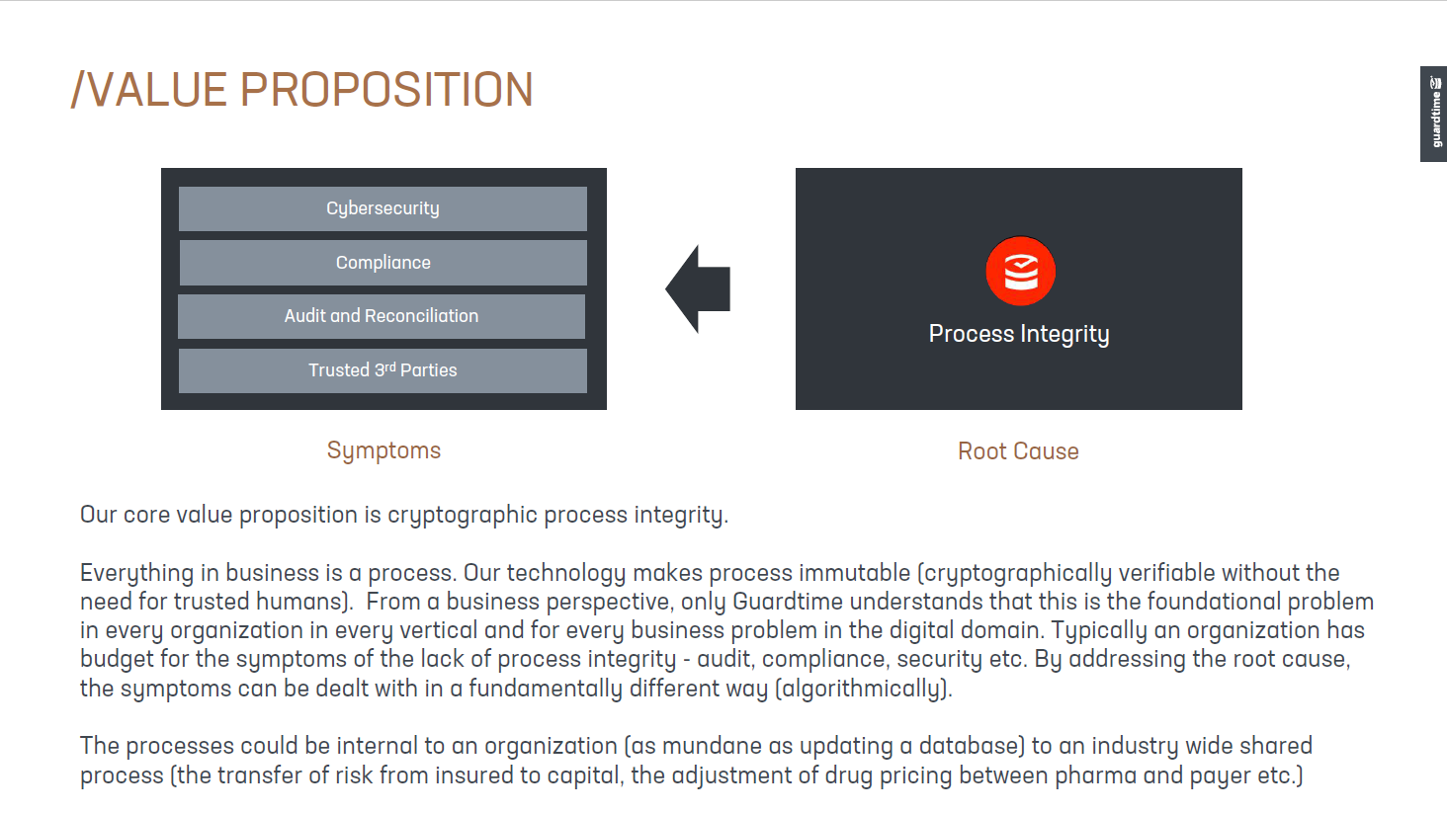
value-proposition of
/ BLockchain-based technology stack

Slide 19

blockchain backed e-health registry
Pharmacy
Hospital
…
Regulatory compliance
Integrity assurance
Minimal deployment friction
Low cost base
Family Doctor
Central E-health database
Audit log
Final medical files
KSI blockchain

Slide 20
The architecture (= technology) is designed to
/ facilitate without limitations for ...
any professional while
working at any provider to
see/exchange any data about
any individual at
any situation.
This is the principle.
For each category rule-based limitations will apply and can be managed! (= legal framework & data governance)

Slide 21










Journey of national eHealth services
/ in Estonia
Collecting health service reimbursement invoices
~1995
Health insurance reimbursement 100% digital (2001)
Deidentified „health data lake“ for R&D
cross-border ePrescription
Digital picture archiving services
Drug interaction & adverse reaction CDSS
Services for dental care
Nationwide EHR services for physicians and patients
eAmbulance services
Digital registration services
Medical certificate services
ePrescription Services
RWD based statistics services
Health status summary for Social Insurance Board
eConsultation services

Slide 22
Fully integrated system requires
/ full transparency & control of data use by citizens
Fundamental principle:
Health data is controlled by the person (‘data subject’) &
enabled via blockchain-powered integrity services
  Access to my data
  Control of my data use
  Delegation of my access and control rights
  Individual monitoring of requests for my data

Slide 23
the value

Slide 24
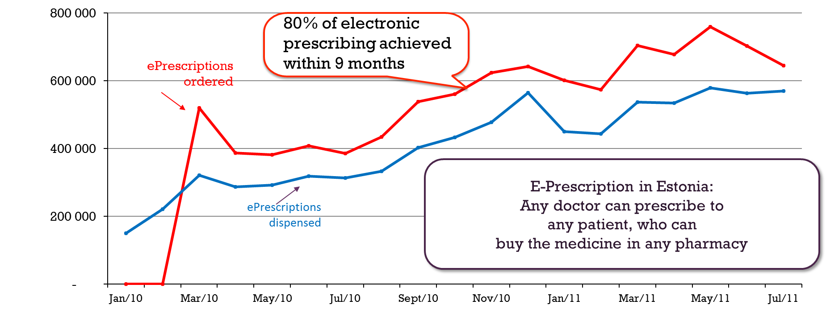
:
Very fast system-wide adoption
/ the case of e-Prescription

Slide 25
Fully integrated digital health services
/ save money
Nationwide integrated and indication based ePrescription service
Administrative costs for error correction dropped by 80%
ROI from reduced paper prescriptions in 2 years
Time spent on repeated prescriptions by doctors dropped 2 times
Liability claims to doctors for mistakenly erroneous prescriptions dropped close to 0
Prescriptions by active ingredient, rather than brand name, went from 50% to 90% of all prescriptions, which reduced patients’ out of pocket costs by about 25%

Slide 26
Trust towards digital society
/ grows over time
Public support to Estonian Genome Foundation
(combining population genomic data with all existing health data)

Slide 27
the reality

Slide 28
Technology
/ Stacked approach
industry solutions
End-user applications & services
customer solutions
End-to-end modular blockchain technology stack, from physical infrastructure (Anti Tamper server hardware if needed) to blockchain to middleware to solution packages.
Unix philosophy to blockchain - abstraction and encapsulation of functionality into components which do one thing well, with minimal complexity, to ensure
scale, performance and resiliency.
3rd party applications
solution support services
APIs
KSI Solutions Packages
component orchestration
policy & events
provenance
APIs
KSI Microservices
middleware components
connectors
accounting services
KSI Resonance /process integrity
APIs
commitment services
storage services
time
APIs
KSI Blockchain / high-scale immutability
integrity
Run Time Security
identity
virtualized nodes
KSI Infrastructure platform
Easy deployment with value-driven
(not technology-driven) cost base.
physical nodes
anti-tamper nodes

Slide 29
A Global Brain
/ FOR Healthcare
+
Biobanks
+
Health Databases
+
Device
Manufacturers
+
Healthcare
Providers
Layered technology stack provides secure connections in the health ecosystem to build various trusted interoperable networks.
Commonly shared APIs for consent, provenance, integrity, access enabling in-house application development or integration with 3rd party applications.
Blockchain-assured
network of autonomous
system participants
+
Patient
+
Regulators
+
Insurance
+
R&D
+
Artificial
Intelligence
+
Life sciences
companies

Slide 30


health data platform, which is purpose built to DELIVER / THE FUTURE OF HEALTH
/build
/Connect
/deploy
STANDARD APIs
Single Version of Truth – Data Immutability
KSI Blockchain
Regulatory Compliance
On-Demand Patient Consent
Derived Consent for Children / Infirm Patients
Dynamic Consent for Emergencies
Anonymization of Patient Data
Digital Twins
Patient Identity Mapping (Cross Platforms)
Medication Tracking (Physical to Digital)
Clinical Trials – Concierge Services
Provenance
Visualize the who, where and what for every interaction across the health ecosystem.
Universal Secure Data Transport
End to End Secure, Encrypted, Blockchain backed transport layer for ‘consent based’ real time sharing of patient data
Directory Services
Advertise or consume HSX enabled services on demand
Supported EHR Systems
Cerner
EPIC
AllScripts
Any third party HL7 / FHIR enabled system
Other Supported Systems
Oracle Clinical Trials
Apple iHealth
Partner Smart Apps (Apple/Android)
Big Data Solutions
STANDARD APPLICATIONS
HELIUM (Data Access and Governance Manager)
Data Access for Outcomes Based Pricing
Dynamic Patient Consent Engine (GDPR)
Medicine Supply Alert
Secure Data & Process Integrator for Medication Adherence
Supply Chain Track and Trace
Complex Clinical Trial Data & Process Integrator
Smart Contracts
CUSTOM APPLICATIONS

Slide 31
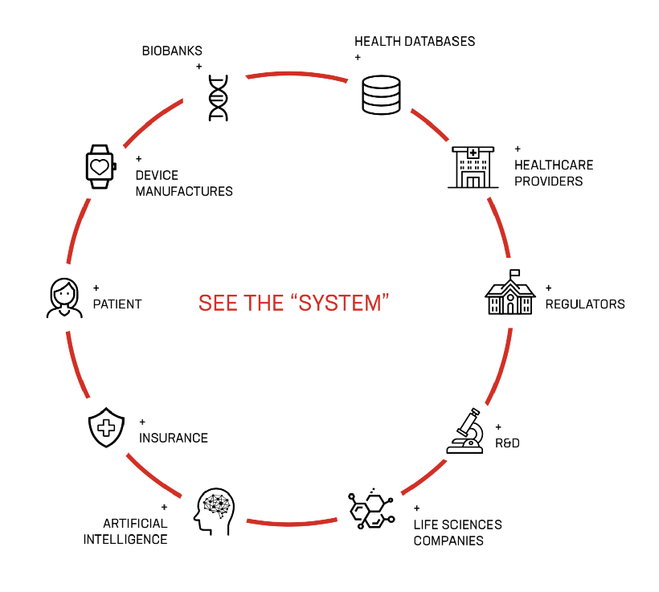
Making data accessible
/ Without sharing if not necessary
… REQUIRES FLEXIBLE APPROACH:
Data-liquidity (=data travels) for the exchange/sharing of personally identifiable health data and/or proprietary patient data. The cornerstone being patient consent.
Data-visibility (=data does not travel) describes the ability to provide aggregated or otherwise masked summaries of sensitive data without revealing any original data to outside parties.
Blockchain is used for immutable proof of what data came where and from, who* created it, who* used (or shared) it for what purpose – to guarantee its trustworthiness.
* Human or a machine/algorithm

Slide 32
Control of data processing
/ Adjusted according to the use-case
… ENABLES VARIOUS PRODUCT OFFERINGS:
HELIUM (Data Access and Governance Manager) for transparent and auditable big data analytics
Outcomes Based Pricing Data Access Manager for privacy-protection
Medicine Supply Alert for
predictive drug shortage management
Secure Data and Pathway Integrator for
medication adherence support
Complex Clinical Trial Data and Process Manager for automated quality assurance and RWD access
Supply Chain Track and Trace for
down- and upstream process accountability
Dynamic Patient Consent Engine for
frictionless privacy management

Slide 33
the future

Slide 34
Blockchain-backed data & process integrity assurance
/ Enables BOLD DIGITAL STRATEGY IMPLEMENTATION in estonia
Full cycle care continuity for chronic conditions - 2020
National quality assessment service for outcome based health system - 2021
Innovative integration of health and social care at the regional/community level - 2021
Clinical decision support systems for adaptive care pathways (including personalized medicine implementation) - 2020
Integration and sharing of personal medical data with 3rd party (non-medical) data services (including personal health record) - 2020
National data-as-a-service framework (1-stop-shop) for secondary use of health data for R&D&I – 2020/2021

Slide 35

The Brave New Healthcare privacy-preserving fully integrated | powered by blockchain
real-time healthcare
value-based payment for services
data-driven personalised decision making
real-world evidence in life sciences
zero-bureaucracy: invisible services
frictionless data governance across borders
© Taaniel Malleus
Notes:
The services you can build on top of such trust foundation of your health data are almost limitless.
All these examples need this immutability of original data as well as robust provenance proof of the authorization and sequence of transactions.

Slide 36
the lessons

Slide 37
Blockchain is useful for practical problem solving in the right context
Notes:
To summarize I’d like to emphasise once again, that in order to get from playing and experinmenting with blockchain as a technology into a real tool for problem solving one should know what is the problem and have a whole toolset available, but not just a hammer looking for nails

Slide 38
security
/ COMBINATION of suitable technologies
integrity
KSI blockchain
availability
secure transport
confidentiality
eID
Notes:
13. Security
Intro: Estonia secures its e-state with the safest possible combination.
Confidentiality - electronic ID is a secure option for a citizen to access his or her personal data and determine or check who else can access it.
Availability – Even though every citizen's data is confidential, all elements in the data exchange system are able to exchange data securely and work smoothly together, while any institution can use the infrastructure and it works as an open source.
Integrity – With KSI Blockchain deployed in Estonian government networks, history cannot be rewritten by anybody and the authenticity of the electronic data can be mathematically proven. All the data exchanges, M2M communications, data at rest, and log files are independently and fully accountable thanks to KSI blockchain technology. This means that no one – not hackers, not system administrators, and not even the government itself – can manipulate the data and get away with it.

Slide 39
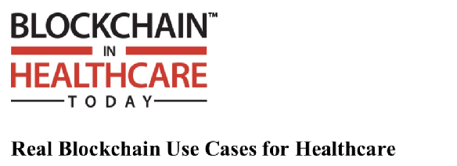
BLOCKCHAIN IS USEFUL FOR
/ PRACTICAL PROBLEM SOLVING
Halamka, J. (2018)
Provide Proof of Work
Guarantee Data Integrity
Support preferred Economic Model
Integrated & automated
supply-chain / clinical workflows
Clinical quality & integrity
Financial integrity
Outcome-based incentives
Notes:
So – according to John Halamka from Harvard university blockchain can help you solve 3 basic problems in healthcare
First – provide proof of work or that something happened
Second – give the guarantee of data integrity that has been presented to you
Third – if you combine the trustworthy data with the verified business processes you can start building economic models that are based on the outcomes rather than inputs or just process
And all of the above can be done with high automation and efficiency is blockchain like KSI is being used.

Slide 40


THANK YOU! ain.aaviksoo@guardtime.com guardtime.com/health
+7181412527
+3BF25278
-A81412DE7
+121412527

Slide 41
ain.aaviksoo@guardtime.com | @ainaaviksoo
www.guardtime.com/health
© 2019 GUARDTIME
All rights reserved

